Slide 1


Center for Educational Data Science and Innovation
June 10
Jing Liu
University of Maryland

Slide 3
Agenda
Review Task Codebook
  V-A-D Background
  Task Description
  Decision rules to help clarify
Annotate Together!
Compare and Reflect on Annotations
Adjust Codebook if needed

Slide 4

The Template Itself
The template is just that - a template. It does not solve all design problems or offer creative solutions. It is meant to provide consistency and a platform for you to compose a compelling presentation. This means finding your own resources, moving objects, changing colors, making connections, and blending those ideas into the base of the brand.
Idea
Communication

Slide 5
Typeface
This presentation uses the Arial typeface. It’s flexible in that it is freely available on all platforms and lends itself to multiple people working on projects across institutions and softwares.
I do not suggest using “shrink text to fit the shape”. This creates scenarios where you overload the slide with text. This slide is an example of the maximum text you should have on a single slide. If you need more space - you need another slide.
When bringing text into a presentation (any presentation) you should either directly type the text or paste text unformatted (CTRL+SHIFT+V)
Using the highlight in a brand color is a good way to draw attention to a specific bit of text on dense slides.

Slide 6

Photographs
Photographs should be given ample space. Do not use tiny photos or poor resolution photos.
It is acceptable for the brand mark (upper right) to be entirely covered. If you wish to replace it - you can find it in the toolkit.

Slide 7



Photographs
Other things of note are photo resources. The umd bynder or zenfolio is free to use for UMD employees and projects. Unsplash, pixabay, pexels are royalty free repositories. Some AI models are also royalty free and can produce sometimes usable visuals.
In terms of constructing layouts you should try to stick closely to a grid. This allows for shapes and photographs to be consistent and professional.

Slide 8


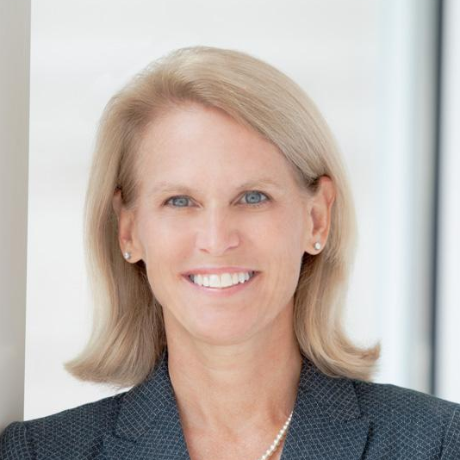
Headshots
Headshots are special instances where you need to pay extra attention.
You want to match head size and eye line. You also want to match photo crop whether that is a square, circle, or other - they all need to be the exact same size and ratio.
Missing any of those steps is disrespectful to the person presented.

Slide 9
Tables, Charts, Infographics
Data and infographics need to be treated similarly to photographs. ‘If it’s worth showing it’s worth being seen’ and that means size, space, and consistency. Your tables should be legible and consistent throughout.
Column 1 | Column 2 | Column 3 | Column 4 | Column 5
Row 1
Row 2
Row 3
Row 4
There are lots of ways to highlight or otherwise draw attention to something in your graphic.

Slide 10
The Plus Symbol
This example uses the plus mark and is indicating the location of that plus in the brand mark
Within the EDSI mark is a plus symbol that is used throughout this presentation and the brand. This is a great tool within the system for call outs or simple decoration.
Related to this is connectors. The brand mark uses both 90 degree angles and curves which opens the door to using curved connectors as well.
Here we see curved connection

Slide 11
Colors
The EDSI primary mark uses the same colors as in the University of Maryland brand toolkit. Gradients throughout this presentation use a combination of these colors and lighter shades to create a robust system for any scenario.
Red
#E21833
RGB 227 25 51
Yellow
#FFD200
RGB 255 210 0
Black
#00000
RGB 0 0 0

Slide 12
Tactics & Strategies

Slide 13
Overall Considerations
As a part of the University of Maryland your presentation should be clean and rely on the University's overall brand as well as the included components here. Beyond that your content should drive the layouts.
It is much better to lean into simple and clean than cluttered and colorful. The content of your research can carry the presentation. Precision and a few concepts will strongly communicate your ideas.

Slide 14




Grids
Grids can be applied to any layout or situation and will help decide the size of objects and keep your presentation professional and thoughtfully designed.

Slide 15
Grids
Grids can be applied to any layout or situation and will help decide the size of objects and keep your presentation professional and thoughtfully designed.

Slide 16
Color Blocking
Color blocking is a good way to regain space when using large visual assets or to add some impact when you want to draw attention to something. It should be used as a change of pace - not every slide. You could also use this tactic to color code sections.

Slide 17
Swapping Sides
There is a theme option to color block on the right side. These options offer flexibility to bend to the resources you have and use your best assets in an appropriate manner.

Slide 18
This template has a variety of layouts, options, and assets set up - it is up to you to make your presentation cohesive and compelling.

Slide 19
Toolkit

Slide 20











Opaque Gradients
Transparent Gradients

